Slide 1
2. Market Opportunity – Democratize Hedge Funds
Aqumon’s goal is to bring the hedge-fund-level investment opportunities that are available to 5% of the population to 95 per cent of the population
Pain Points
Hedge funds are only open to "accredited" or qualified investors.
Qualified investors of a hedge fund refer to the entities and individuals with corresponding risk identification ability and risk bearing ability.
In mainland China:
Invest not less than 1 million yuan in a single hedge fund.
Enterprises with net assets not less than 10 million yuan;
Individuals whose financial assets are no less than 3 million yuan or whose average annual personal income is no less than 500,000 yuan in the recent three years.
Retail Investors do not have the access to many financial instruments that are only available for big institutions.
Financial Derivatives for hedging, such as options and futures
Global Asset Allocation

Slide 2

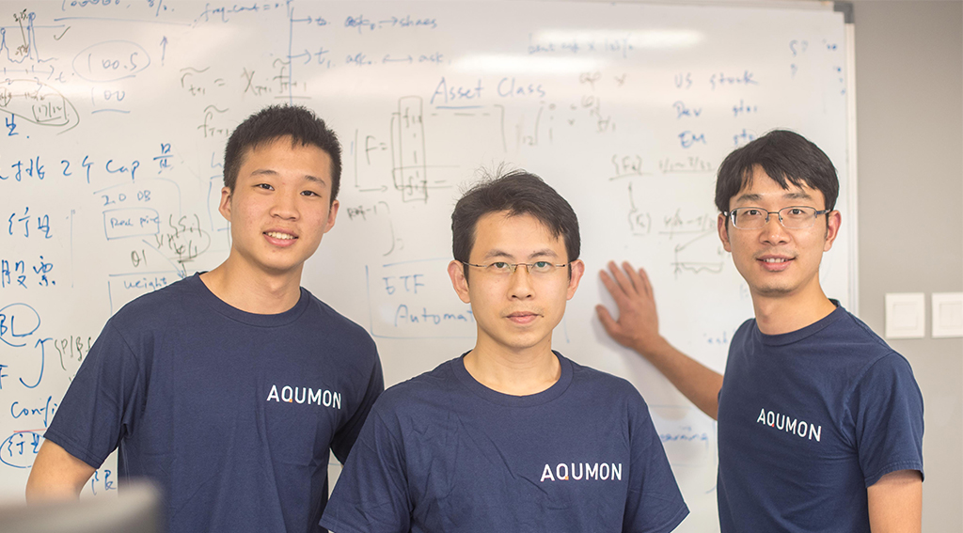

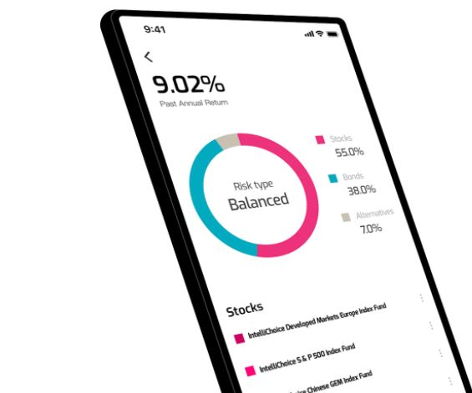
Business Model
FOHF management fee as Robo-Advisor
Hands-on Review Portfolio
Quantitative technical support for professional investment institutions
Sales Revenue from sale of algorithms and strategies to professional investment institutions

